Slide 1


Slide 2


Slide 3
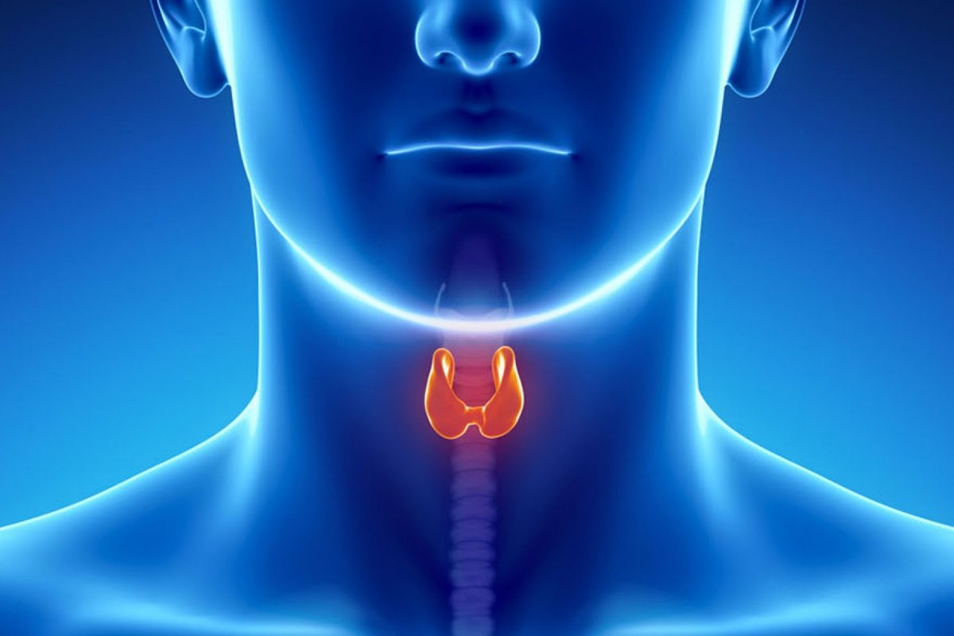
HYPOTHYROIDISM
Prepared by :
Bandana Tiwari
Roll no: 6
BNS 2nd year

Slide 4
General Objectives
At the end of the classroom session , BNS 1st year students will be able to explain about hypothyroidism and age related changes in genitourinary system .

Slide 5
Specific Objectives
At the end of this teaching session, the BNS 1st year will be able to :
define hypothyroidism
list the causes of hypothyroidism
enlist the sign and symptoms of hypothyroidism

Slide 6
Cont..
enlist the diagnostic investigation of hypothyroidism
explain the management of hypothyroidism
explain the nursing management of hypothyroidism
list the complication of hypothyroidism
explain the age related physiological changes in genitourinary system

Slide 7

HYPOTHYROIDISM

Slide 8
INTRODUCTION
Hypothyroidism is a clinical state which results from a decreased production of thyroid hormone from thyroid gland or , rarely, tissue unresponsiveness to normal concentration of circulating thyroid hormones.
Thyroid deficiency can affect all body function and can range from mild , subclinical forms to myxedema (severe deficiency and advanced life threatening form).

Slide 9
Cont..
Definitive diagnosis requires demonstration of high TSH value with low T3 and T4 concentrations.
Hypothyroidism is a common problem in older subject with a strong particularly for female sex .

Slide 10
TYPES
PRIMARY HYPOTHYROIDISM:
It is characterized by low T4 with an elevated TSH level due to destruction of thyroid tissue or defective hormones synthesis.
2)SECONDARY HYPOTHYROIDISM:
It is characterized by low T4 and low TSH due to insufficient pituitary secretions of thyroid stimulating hormone and dysfunction of hypothalamus.

Slide 11
Cont…
3) TERTIARY HYPOTHYROIDISM:
Result when the hypothalamus fails to produce sufficient thyrotropin releasing hormone(TRH).
4) SUBCLINICAL HYPOTHYROIDISM:
It can exist in which the person is asymptomatic but TSH level is elevated and T4 is normal.

Slide 12
CAUSES
Hashimoto’s thyroiditis
2) Lymphocytic thyroiditis following hyperthyroidism
3) Thyroid destruction secondary to radioactive iodine or surgery
4) Pituitary or hypothalamic disease

Slide 13
Cont..
5) Pituitary injury
6) Medications
7) Sever iodine deficiency
8) Radiation therapy

Slide 14
COMMON SIGNS AND SYMPTOMS:
1) Early symptoms
Being more sensitive to cold
Constipation
Depression

Slide 15
Cont..
Joint or muscles pain
Paleness and dry skin
Thin, brittle hair of fingernails

Slide 16
2) Late symptoms, if left untreated
Decrease taste and smell
Hoarseness
Puffy face, hands, and feet
Slow speech
Thickening of skin

Slide 17
3) Signs
Bradycardia
Hypertension
Gynecomastia
Delayed deep tendon reflexes

Slide 18
DIAGNOSTIC INVESTIGATION
History taking
Physical examination
Thyroids stimulating hormone (TSH)assay
Thyroxine (T4) radioimmunoassay.

Slide 19
Cont..
Tri-iodothyronine(T3) radioimmunoassay.
Thyroid autoantibodies

Slide 20
TREATMENT
Start patient on L-thyroxine 50-100mcg PO OD.
L-thyroxine treats the hypothyroidism and leads to regression of goiter.
If the patient is elderly or has IHD start 12.5-25mcg PO OD.

Slide 21
Cont..
Check TSH level after 4-6 weeks to adjust the dose of L-thyroxine.
In case of pregnancy check TSH every month L-thyroxine dose requirement tends to go up as the pregnancy progresses.

Slide 22
NURSING MANAGEMENT
ASSESSMENT
Assess the condition of the patient.
Monitor vital sign of the patient.
Assess the patient bowel pattern.
Assess the patient knowledge regarding disease condition.

Slide 23
NURSING DIAGNOSIS
Decrease cardiac output related to decrease metabolic rate.
Constipation related to decreased bowel mobility.
Activity intolerance related to reduced metabolic rate.
Deficient knowledge related to self care needs for thyroid hormone replacement therapy.

Slide 24
NURSING INTERVENTION
Monitors vital signs, including heart rate and rhythm.
Administer thyroid replacement, levothyroxine sodium which is most commonly prescribed.
Instruct the client about thyroid replacement therapy.

Slide 25
Cont..
Instruct the client in low-calories, low-cholesterol, low-saturated fat diet.
Assess the client for constipation; provide fibrous food and fluid.
Provide a warm environment for the client.
Monitor for overdose of the thyroid medications, characterized by tachycardia, restlessness, nervousness, and insomnia.

Slide 26
COMPLICATION
Goiter
Heart problems
Mental health issues
Peripheral neuropathy
Myxedema

Slide 27
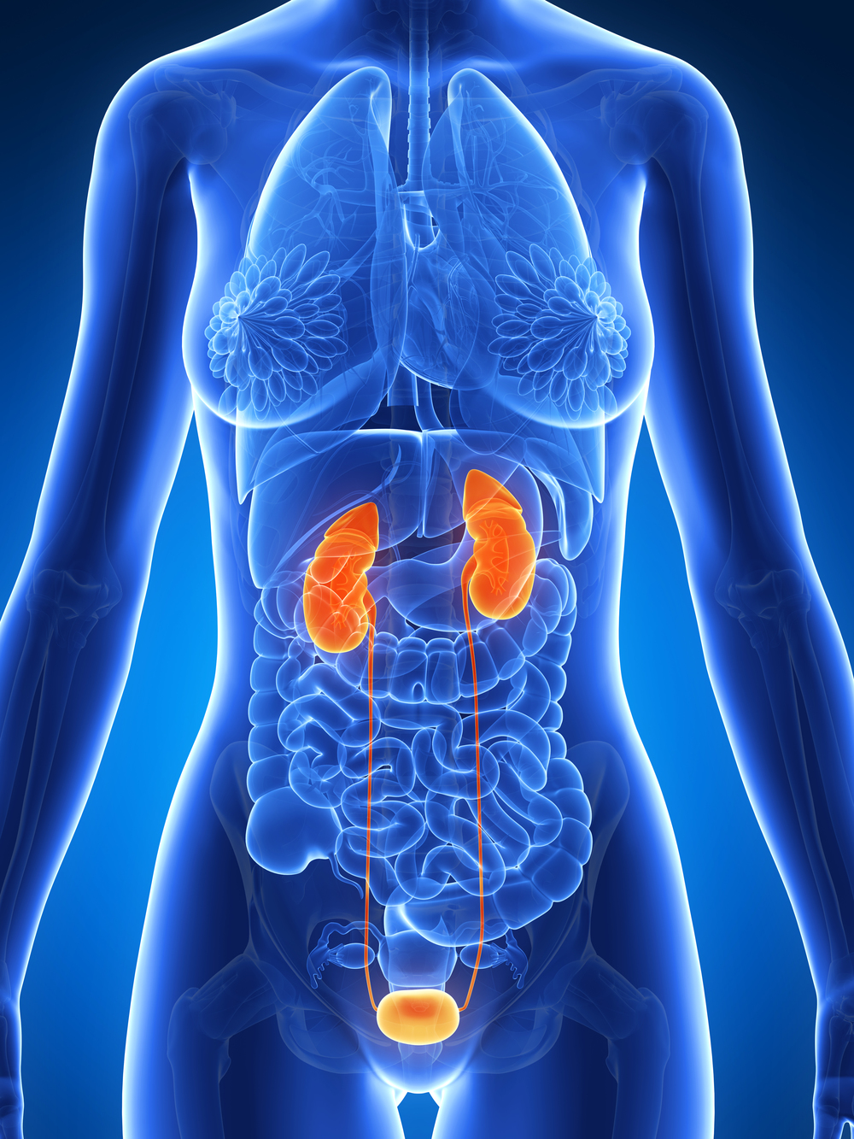

Slide 28

AGE RELATED CHANGES IN GENITOURINARY SYSTEM

Slide 29
CHANGES IN URINARY SYSTEM
The kidney
Renal size and mass decreased by 25% to 30%.
Loss of glomeruli much as 30-50% by the age of 70.
Renal tissue growth decline and atherosclerosis may promote atrophy of the kidney.

Slide 30
Cont..
Aging kidneys manifest changes at the level of filtering units, nephron and blood supply:
Renal tubule.

Slide 31
Tubule degeneration:
Impaired capacity to dilute, concentrate, acidify urine, impaired sodium regulation.

Slide 32
The bladder
Bladder capacity decreases.
The micturition reflex is delayed.
The elastic tissue become tough, and bladder become less stretchy.

Slide 33
Cont..
Muscle tone decrease in the ureters, bladder and urethra leading to some impairment of complete emptying of bladder.
Dehydration can occur if older person reduce fluid intake in an attempt to reduce bladder control problem.

Slide 34
Weaken urinary sphincter
Bladder capacity decline from an average 500 ml in young people to 250 ml in elderly.
Stretch receptor become less sensitive, than urge to urinate occur later.
If there is diminished cerebral function or degeneration of the inhibiting nerve than bladder may empty involuntarily.

Slide 35
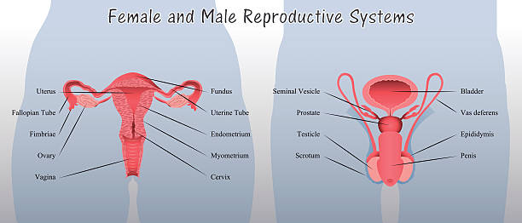
CHANGES IN REPRODUCTIVE SYSTEM

Slide 36
CHANGES IN REPRODUCTIVE SYSTEM
Female
Ovary
The number of quality on the oocyte declines with age.
Postmenopausal ovary little response to gonadotropic hormone and eventually it become fibrotic.

Slide 37
Cont..
b) Vulva and vagina
Atrophy of the vulva from hormonal changes, accompanied by the loss of subcutaneous fat and fair and flattening of the labia.
Vagina of the older appears pink and dry with a smooth , shiny canal because of loss of elastic tissue and rugae.
Vaginal epithelium becomes thin and avascular.

Slide 38
Cont..
The vaginal environment more alkaline.
Labia are no longer elevated and fat under mons pubis is much reduce.
A loss of elastic tissue and vaginal muscle is replaced by fat which predisposed to utero-vaginal prolapse.

Slide 39
c) Uterus
The uterus shrink and endometrium atrophies.
Ligament of the supporting uterus weaken cause backward titling of uterus.
The fallopian atrophy and shorten with age.
Estrogen depletion cause weakening of pelvic floor muscles.

Slide 40
d) Breast
Replacement of granular breast tissue with fat.
Increased the risk of malignancy in the aging breast depend on stimulation of estrogen and prolactin .

Slide 41
II. Male
Seminal vesicle are affected by smoothing of mucosa, thinning of the epithelium, replacement of muscle tissue with connective tissue and reduction of the fluid retaining capacity.
Structural changes can cause a reduction in sperm count.
The secretion of testosterone decreased.

Slide 42
Cont..
Venous and arterial sclerosis.
Excitement build more slowly and erection take longer to attain.
Erection is rapidly loss after ejaculation.
Prostatic enlargement occur.

Slide 43


Slide 44


Slide 45
POST TEST
Fill in blanks
The complication of hypothyroidism is….
Thyroid storm
Graves eye disease
Myxedema
Osteoporosis

Slide 46
True or false
In hypothyroidism TSH is high and T3 and T4 is low .
(True)
2) During aging erection take short to attain .
(False)

Slide 47
ASSIGNMENT
What do you understand about hypothyroidism? Write the treatment and nursing management of it.
Write the age related physiological changes in genitourinary system.

Slide 48
PLAN FOR NEXT CLASS
We will discuss about benign prostatic hyperplasia and uterine prolapse .

Slide 49
REFERENCES
K.C, T, & Rai, B, (2019). A Textbook of Geriatric Nursing. (3rd ed). Heritage publisher and distributors.
Subbha.K,H & Subedi, P,S,(2019). A Textbook of Geriatric Nursing. (1st ed). National book centre.
Baral.R, Essential of Geriatric Nursing. Makalu publication.
Pradhan.M,K & Roka, A,T.(2015). Gerontological Nursing for BN/BSN Students. (1st ed) Vidyarthi publication.
Timalsina,R, (2020). Comprehensive Textbook of geriatric Nursing (3rd ed). Samiksha publication.

Slide 50


